Slide 1
Part 4 Django Project App
Version: 4.0.1
Written and design by: Babar ali

Slide 2
What is App in Django Project?
An app in Django is a sub-module of a project, and it is used to implement some functionality. Now, you can refer to an app as a standalone python module that is used to provide some functionality to your project.
We can create multiple apps within a single Django project.
It’s those little components that together make up your project. They are the features of your project.

Slide 3
Let’s understand the app
In our case (shopping site) it would be:
app 1
Product
app 3
Profile
Website
Shopping site
app 2
Cart
app 4
Users

Slide 4
How to create app for Django project?
The following method is created app for your Django project.
First of all access your project folder then write the following command in CMD.
Shell
>>> python manage.py startapp <app_name>
// Example of creating app
>>> python manage.py startapp first_app

Slide 5
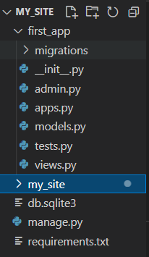
After the app creation
The screen shot is help you how your project looks like:
The app is created name is “first_app” and some file is created automatically by Django the files are:
__init__.py
admin.py
apps.py
models.py
views.py

Slide 6
Add URLS.py file in your app
Create a URLS.PY file in your app. This can help you to create a urls for the “first_app” app in your project. Add a function name and run it.
my_site/first_app/urls.py
my_site/first_app/views.py
from django.urls import path
from . import views
urlpatterns = [
path('',views.home_page)
]
from django.http import HttpResponse
# Create your views here.
def home_page(request):
return HttpResponse("Home Page")

Slide 7
How to add app URLS in Project?
It is very important to add the URLS of the app in your project because they have access or run all your app URLS from the main URLS file. The code are below.
my_site/urls.py
from django.contrib import admin
from django.urls import path
from django.urls import include
from . import views
urlpatterns = [
path('admin/', admin.site.urls),
path('', include('first_app.urls'))
]

Slide 8
How to add app URLS in Project?
The “include” is used to add the app URLS in Django project.
my_site/urls.py
from django.urls import include
This is the way you can add the app URLS in project just write the app name.
my_site/urls.py
path('', include('first_app.urls'))

Slide 9
Thanks for Reading

